Slide 1
ist 263

Slide 2
Agenda
Layout
Containing Elements
Floats
Flexbox

Slide 3
Containing Elements

Slide 4
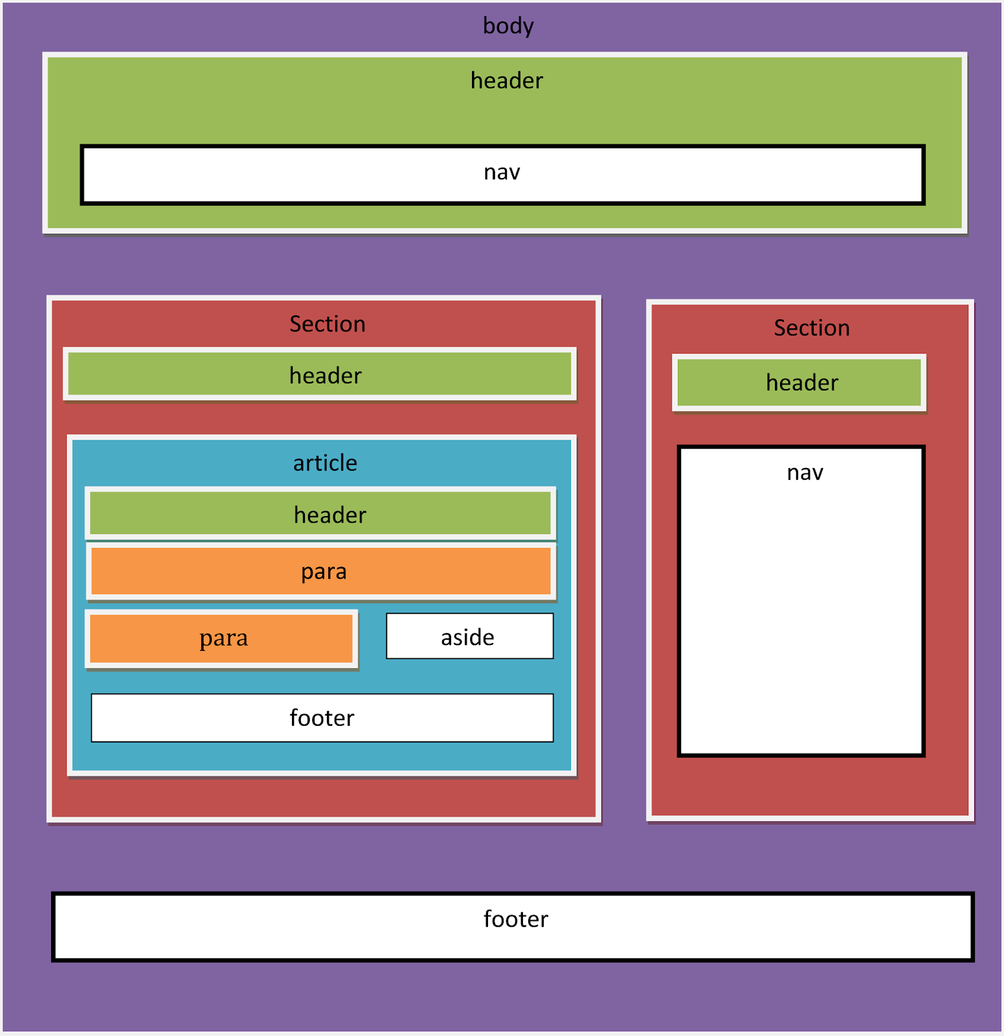
Containers

Slide 5
Semantic Containers
<article>
<aside>
<details>
<figcaption>
<figure>
<footer>
<header>
<main>
<mark>
<nav>
<section>
<summary>
<time>

Slide 6
Non-Semantic Container Elements
<div>
<span>
Div is a block element and span is an inline element.

Slide 7

syr.edu

Slide 8
<header></header>
<nav></nav>

Slide 9
<article></article>

Slide 10

<footer></footer>

Slide 11
Floating inline and block elements

Slide 12
What is a float?
An element pushed to left or right allowing everything after the element to wrap around it.

Slide 13
Clearing Floats
To stop the rest of the page from flowing around an element use the clear CSS property.

Slide 14
Properties for Floats
Property | Values | Example
float | left or right | .firstimage {float: left;} | All content after the float will flow around the floated item.
clear | both | div {clear: both;} | Stops any float that has been applied before this property.

Slide 15
Flexbox

Slide 16
What is Flexbox?
A way of laying out elements on a web page.
Elements/containers are laid out in rows and columns.

Slide 17
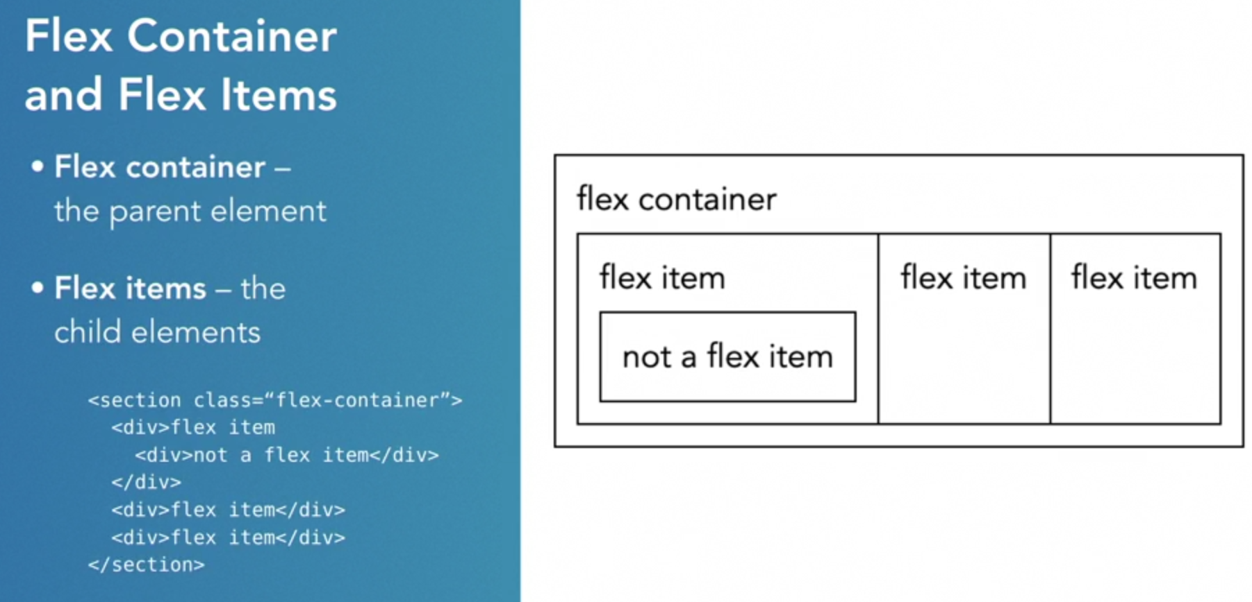

Slide 18
Properties for Flexbox
Property | Value(s) | Example
display | flex | div {display: flex;} | Children of this container are going to display side by side
flex | 1, 2, 3 … | div {flex: 1;} | Sets ratio size of container in row
flex-basis | 20%, 30%,… | div {flex-basis: 20%;} | Sets percentage size of container in row
order | 1, 2, 3 … | div {order: 1} | Defines order of container in row
justify-content | space-between | div {justify-content: space-between;} | Defines where extra space between containers will display
flex-wrap | wrap | div {flex-wrap: wrap;} | By default, flex items will all try to fit onto one line. You can change that and allow the items to wrap as needed with this property.
https://css-tricks.com/snippets/css/a-guide-to-flexbox/

